Slide 1
Melanoma Long-Term Monitoring
By Ciaran Carroll
Supervisor’s: Sean McGrath and Colin Flanagan

Slide 2
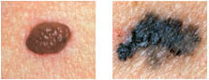
Introduction
Melanoma is a group of skin cancers that start in pigment cells (melanocytes) in the skin
It is the deadliest form of skin cancer as it can spread to other parts of the body
Although it accounts for only 3-4% of all skin cancers, it is responsible for 75% of all the skin cancer deaths
Skin cancer is well suited for image processing techniques as the abnormal moles are visible on the skin
Benign vs Malignant mole

Slide 3
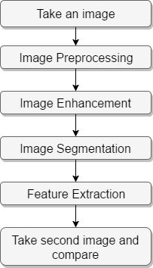
Introduction cont.
In this project, I will develop a system that will be able to monitor the progress of Melanoma (Skin cancer) on a patient’s arm over a couple of months
Required steps for this project:

Slide 4
Build enclosure and take images of arm
Enclosure will be connected to Raspberry Pi
Fitted with multiple cameras to get a full representation of the arm
Aim: To make the lighting of the image controllable

Slide 5
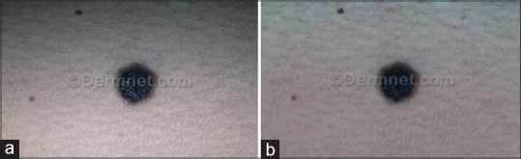
Image Pre-processing/Enhancement
Preparing the image for analysis by improving the quality of the image
Many Image pre-processing and enhancement techniques will be tested for desired results
Image pre-processing may include noise removal and colour transformation
Image enhancement may include applying a median filter and image smoothing
Aim: Remove hairs, skin lines, shadow and other artefacts that affect the quality of the image
Images processed of mole by applying a median filter and shadow reduction

Slide 6
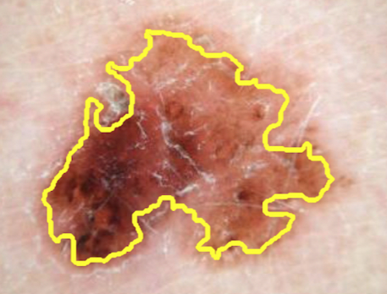
Image Segmentation
Partitioning the image into meaningful regions or objects
Done by separating the objects in the image and removing the unwanted regions
Various image segmentation methods will be tested
Aim: Remove the skin and background from image
The main method tested: Otsu’s thresholding
Border detection of Malignant mole

Slide 7
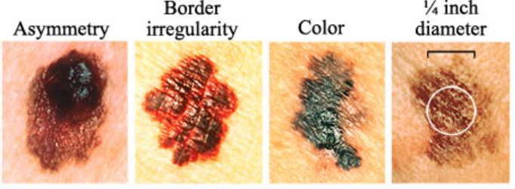
Feature Extraction
Transforms the image into features of distinct properties
Based on ABCD criteria: A-Asymmetry, B-Border irregularity, C–Colour variation and D-Diameter
Aim: Obtain valuable information from the images
Two main feature methods will be tested
Extract information from moles using Image manipulation program using Python library OpenCV
Extract information from moles using formulas to measure features
Features of Melanoma

Slide 8
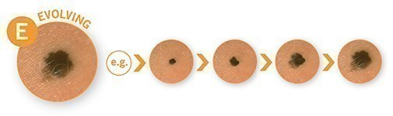
Take second image and compare
Take the second set of images of the arm in the same positions
Compare information from the feature extraction steps and the number of moles on the arm in both images
It will allow me to measure the progress of the melanoma on the arm
If changes are noticed new treatments may be necessary
Aim: To determine if a mole has evolved, changed in colour or if any new mole has appeared
Image of an Evolving mole

Slide 9
Summary
Building an enclosure to image the arm and writing a program to analyze the image
Analysing images of an arm using Image Pre-processing/Enhancement, Image Segmentation, and Feature Extraction
Comparing images of the arm to measure the progress of the Melanoma
Could potentially become an important tool for GPs and dermatologists in monitoring melanoma

Slide 10

Questions

